Slide 1

Introduction to
HTML5

Slide 2
History of HTML
1991
HTML first
published
1995
HTML 2.0
After HTML 4.01 was released, focus shifted to XHTML and its stricter standards.
1997
HTML 3.2
1999
HTML 4.01
XHTML 2.0 had very strict standards but was abandoned in 2009 in favor of HTML5.
2000
XHTML 1.0
HTML5 is much more tolerant and can handle markup from all the prior versions. A working draft was released in 2012 and it is scheduled to be finalized by the end of 2014.
2002 -2009
XHTML 2.0
2012
HTML5
2014
HTML5.1
HTML5.1 is currently under development and expected to be finalized in late 2016.

Slide 3
What is HTML5?
HTML5 is the newest version of HTML, only recently gaining partial support by the makers of web browsers.
It incorporates all features from earlier versions of HTML, including the stricter XHTML.
It adds a diverse set of new tools for the web developer to use.
It is still a work in progress. No browsers have full HTML5 support. It will be many years – perhaps not until 2018 or later - before being fully defined and supported.

Slide 4
Goals of HTML5
Support all existing web pages. With HTML5, there is no requirement to go back and revise older websites.
Reduce the need for external plugins and scripts to show website content.
Improve the semantic definition (i.e. meaning and purpose) of page elements.
Make the rendering of web content universal and independent of the device being used.
Handle web documents errors in a better and more consistent fashion.

Slide 5
New Elements in HTML5
<article>
<aside>
<audio>
<canvas>
<datalist>
<figure>
<figcaption>
<footer>
<header>
<hgroup>
<mark>
<nav>
<progress>
<section>
<source>
<svg>
<time>
<video>
These are just some of the new elements introduced in HTML5. We will be exploring each of these during this course.

Slide 6
Other New Features in HTML5
Built-in audio and video support (without plugins)
Enhanced form controls and attributes
The Canvas (a way to draw directly on a web page)
Drag and Drop functionality
Support for CSS3 (the newer and more powerful version of CSS)
More advanced features for web developers, such as data storage and offline applications.

Slide 7
First Look at HTML5
Remember the DOCTYPE declaration from XHTML?
<!DOCTYPE html PUBLIC "-//W3C//DTD XHTML 1.0 Transitional//EN"
"http://www.w3.org/TR/xhtml1/DTD/xhtml1-transitional.dtd">
In HTML5, there is just one possible DOCTYPE declaration and it is simpler:
<!DOCTYPE html>
Just 15 characters!
The DOCTYPE tells the browser which type and version of document to expect. This should be the last time the DOCTYPE is ever changed. From now on, all future versions of HTML will use this same simplified declaration.

Slide 8
The <html> Element
This is what the <html> element looked like in XHTML:
<html xmlns="http://www.w3.org/1999/xhtml" xml:lang="en" lang="en">
Again, HTML5 simplifies this line:
<html lang="en">
The lang attribute in the <html> element declares which language the page content is in. Though not strictly required, it should always be specified, as it can assist search engines and screen readers.
Each of the world’s major languages has a two-character code, e.g. Spanish = "es", French = "fr", German = "de", Chinese = "zh", Arabic = "ar".

Slide 9
The <head> Section
Here is a typical XHTML <head> section:
<head>
<meta http-equiv="content-type" content="text/html; charset=utf-8" />
<title>My First XHTML Page</title>
<link rel="stylesheet" type="text/css" href="style.css" />
</head>
And the HTML5 version:
<head>
<meta charset="utf-8">
<title>My First HTML5 Page</title>
<link rel="stylesheet" href="style.css">
</head>
Notice the simplified character set declaration, the shorter CSS stylesheet link text, and the removal of the trailing slashes for these two lines.

Slide 10
Basic HTML5 Web Page
Putting the prior sections together, and now adding the <body> section and closing tags, we have our first complete web page in HTML5:
<!DOCTYPE html>
<html lang="en">
<head>
<meta charset="utf-8">
<title>My First HTML5 Page</title>
<link rel="stylesheet" href="style.css">
</head>
<body>
<p>HTML5 is fun!</p>
</body>
</html>
Let's open this page in a web browser to see how it looks…

Slide 11
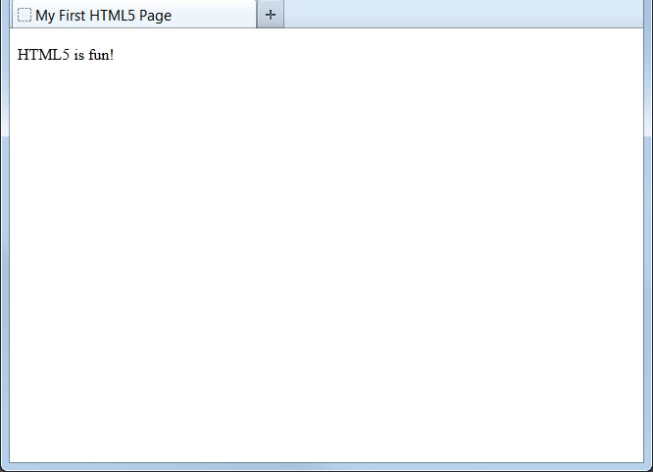
Viewing the HTML5 Web Page
Even though we used HTML5, the page looks exactly the same in a web browser as it would in XHTML. Without looking at the source code, web visitors will not know which version of HTML the page is in.

